Slide 1
PML Makerspace Survey
Updated September 2019

Slide 2
Link to Survey
Link to Data
https://pmlib.org/makerspace-survey/
https://airtable.com/shrZqVVldb89gYIix

Slide 3
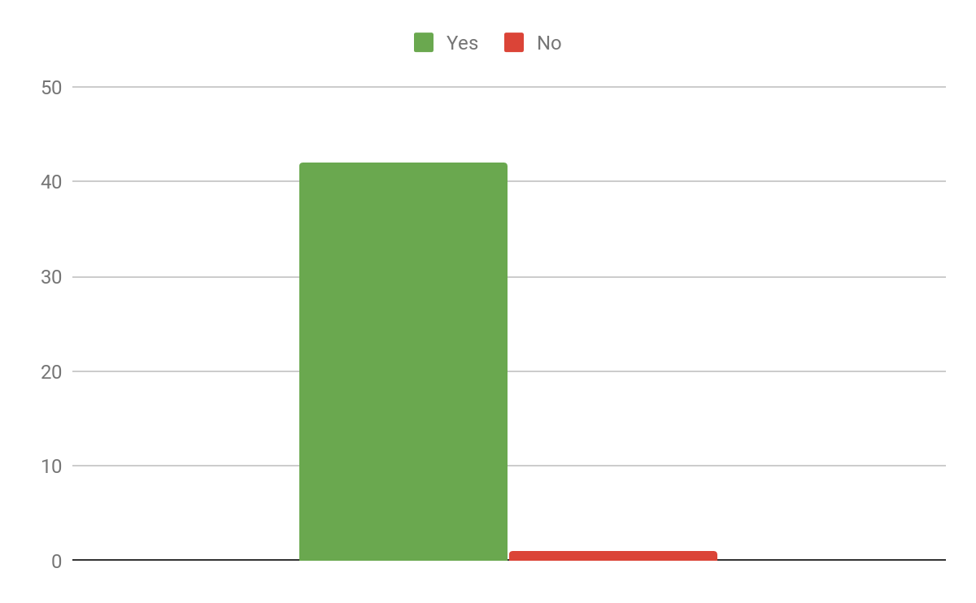
Would you use a Makerspace in the library?

Slide 4
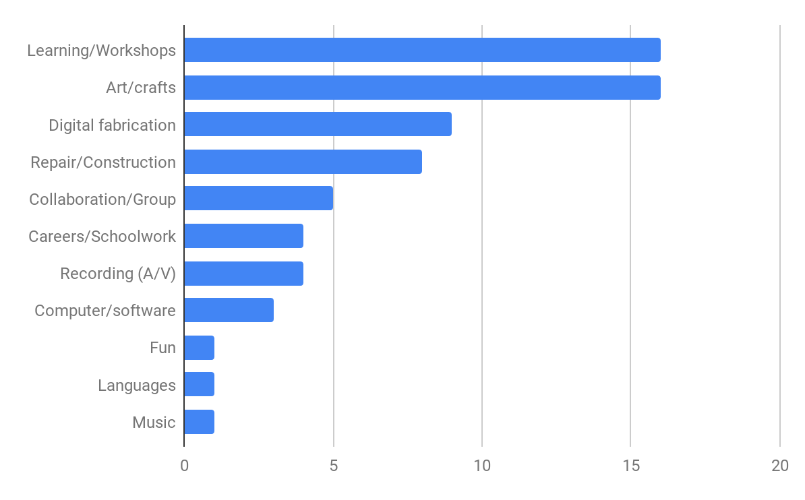
What would you use it for?

Slide 5
Responses: Learning/Workshops
Learning. | To learn new things/techniques
Interactive workshops and seminars. | To learn more and build
For learning and fun | Maybe instructors sometimes
Learn something new, interesting and practical to use in my home.
Make each learning/doing session in drop-in format so people don't need to be there from the beginning - and they won't feel awkward showing up.
Learning how to do things I currently can not do but would like the ability to do.
I do hope that whatever the library does decide about the makerspace that they will also offer someone to help us learn about the different tools/programs that they will be offering :)
quality information and service from trained professionals. It depends on what you choose, but the most important thing is to have trained people and resources dedicated to the makerspace service. I would like more library programs.
Must have a staff person on duty to help and teach use of tools

Slide 6
Responses: Art/Crafts
Painting, drawing, calligraphy. | I would use it for space to create. Photography, large format printing on different types of surfaces
My wife and I collect sea glass. It would be fun to make something with it, wind chimes, jewelry etc. | Leathercraft (keychains, wrist bands, wallets)
fiber | Sewing, knit/crochet, card making, wreaths
Paper crafts, Painting | Sculpting and paper clay I sculpt, doll faces and bodies, dogs. However you can sculpt anything with paper clay! Jewelry
learning how to quilt, knit, crochet, etc. | Scale modeling
Crafting | To crochet or make keychains
Jewelry | To make craft projects

Slide 7
Responses: Repair/Construction/Utilitarian Items
Construction with tools. A volunteer retired builder to give lessons on large scale wood construction or a retired furniture repair person explaining how to fix damaged furniture.
life hacks; utilitarian crafting
car/small appliance/computer repair
A place to spray paint furniture would be great. I'd spray paint my wicker furniture. I could also imagine the repair classes to be held at the library. I would like to learn to build furniture.
Making parts for home use, educational items for children
Design and print small parts that you can't get from any place
Woodworking, home repair stuff?

Slide 8
Responses: Collaboration/Group Activities
I liked the idea that kids were playing board games with others who spoke different languages so they could learn words and phrases in a real setting. I would like to do that with other adults.
STEAM activities and workshops for parents and children to attend together.
Collaborative Projects
group activities
I would continue to use it to meet with fellow fiber artists to increase my knowledge of knitting and crocheting

Slide 9
Responses: Computer/Software Use
computer program usage
creating or editing pictures
Aprender hacer páginas webs [learn to make web pages]
Coding
Video editing photo editing web development

Slide 10
Responses: 3D Printing
3D printing
3D printing
3-D Printing
100% 3D printer. Resin and plastic would be cool
This sounds like a good place for people that enjoy 3d printing to be creative
3D printing, laser engraving
3D printing/CNC

Slide 11
Responses: Recording (A/V)
becoming a youtuber
Recording podcasts, recording music, editing audio & video, recording videos
I would like to start a podcast with my friends!

Slide 12
Responses: Careers/Schoolwork
Job search. Meet with local mfg companies
Homework
I would use it for workrooms, for workshops and for program preparation.
Projects for school
Marketing for clubs, logos

Slide 13
Responses: Languages
Learn a new language...learn the old school teachings of a new language, so that what is learned is applied properly. Hear, write, read, speak, repeat.

Slide 14
Responses: Music
musical makerspace activities would be incredible

Slide 15
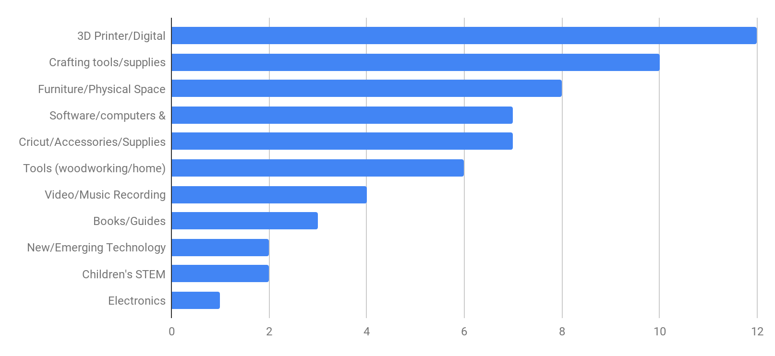
What kind of tools would you like to see in the Makerspace?

Slide 16
Responses: 3D Printer/Accessories
3D printers.
3D printer, 3D scanner
3d printer & digital tools
3-d printer
3-D Printers. Printing materials used in the 3-D printer should be eco-friendly and biodegradable.
3d printer, Laser cutter, CNC machine, laser engraver
sand blasting station to create surface finish and small spray paint station to paint the 3d parts and small drill press to add small holes to 3d parts as needed, and Magnifier lamp to see fine detail on the 3d parts and lastly A bin of assorted small screws, nuts and washers to connect 3d parts together also screw driver flat head and Phillips.
Engraver

Slide 17
Responses: Cricut Accessories/Supplies
Cricut.
cricut cutter
Accessories for the Cricut machine. I would like to see Cricut set up in this room. I would also like to see classes added for the Cricut machine and its accessories.
Cricut. Papers (new, donated, recycled)
Another Cricut/silhouette.

Slide 18
Responses: Furniture/Physical Space
Desks or tables
larger scale project assembly that’s difficult to do on a regular kitchen table, large tables and smocks for paper-crafting/scrap-booking, comfortable chairs with good lighting
Spray painting booth.
a desk, a comfortable chair
Would need well ventilated area
Bean bags, tables
Unsure -- just space is what we really need. I feel we have outgrown the space in front of the library on the main floor [Fiber artists]
A place to donate unused tools

Slide 19
Responses: Software/Computers & Tablets/Peripherals
Video editing software, Photoshop and or other photo editing software, Drawing tablets, Music production / Audio editing software
self-serve color printers for photo printing etc- pay-as-you-go
Diseño de páginas web [web page design]
an ipad and access to main online libraries.
Tools for people who need help with documents, letters or forms
Adobe Creative Cloud, atom.io

Slide 20
Responses: Tools (woodworking/home)
Bench tools
Hands on work tools for wood work. (Non-electric) If you aren't able to use non-electric tools you should not be using electric ones. shaving tool, miter box, variety of saws, dovetail cutter, chisel, awl, plane, mallet, square, hammer, mallet, scraper, rasp, clamps, sanding block and papers, squares, brace with bits, utility knife, upholstery hammer, screws, bolts, and a variety of nails.
Small drill, pliers, scissors etc.
I think it would be good to have power tools to borrow. I've heard they have this kind of thing in other places.
Woodworking -- lathes etc.

Slide 21
Responses: Video/Music Recording Equipment
digital music
vlogging cameras, lighting, special effects makeup
Microphones, Camera, Green Screen
microphones and headphones would be important to creating the podcast!

Slide 22
Responses: Crafting Tools/Supplies
A Weaving loom would be nice :) | Sandpaper, exacto knife, paints, putty, airbrush,
sewing machines, glue guns, how-to | Marker, paper
Embroidery Machine. Sewing Machines. Sewing Tools. Craft Punches. | Pens, pencils, crayons, markers, ruler, different types of paper
Letters -- tooling leather punches, designs, marble for hammering leather, hammer | sculpting tools and wire
Cricut, cutting mats, rotary cutters, sewing machines | Hand lettering, screen printing
guides, large paper cutter, large fabric cutter. craft/maker supply cabinets/drawers to be filled with donated/recycled materials- i.e. supply exchange should be similar to seed exchange

Slide 23
Responses: Books/Guides
A guide for each item.
collection of project books
projects w/steps from library

Slide 24
Responses: New/Emerging Technology (general)
High tech
The most recent gadgets on the market.

Slide 25
Responses: Electronics
Labs setup to learn practical everyday uses of maker electronics in the arduino-type. LED efficiency lighting for home uses (not just screw in light bulbs).

Slide 26
Responses: Children's STEM toys/projects
Wikki Stix, legos, blocks
Snap circuits, QBA maze, science toys and projects

